Slide 1

The Money Exchange Method
[Cards] Company.

Slide 2
The Money Exchange Method
[Cards] Company.
Version.1.0

Slide 3
New User Registration / Login.
New User?.
Sign Up
Already Registered?.
Login
Email.
Password.
Sign In
Forgot Password?

Slide 4
Sign Up / New User Registration.
Full Name.
National Identification Number.
Email.
Password.
Confirm Password.
Create PIN.
Confirm PIN.
Telephone Number.
CCountry.y
Register.

Slide 5
Face Recognition.
Activate Camera.
Capture.

Slide 6
Fingerprint Recognition.
Confirm
Fingerprint.

Slide 7
Registration Confirmed!.
Login.
Email.
Or.
Telephone Number.
Password.
Sign In.
.
Forgot Password?

Slide 8
Receive One Time Code?.
By Email?.
Or.
Telephone?.

Slide 9
Password Reset.
Enter OTP.
Re-send Code?.
Type Password.
Re-type Password.
Login.

Slide 10
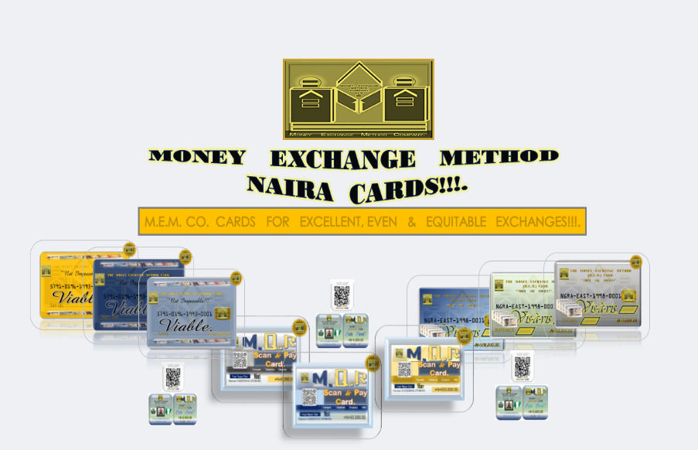
User Name.
Telephone Number.
Available Balance.
Available
M.E.M. Cards.
Air Time
Load & Send M.E.M. Cards.
Transaction
History.
Data.
Transfer Money.
[ M.E.M. Cards’ Photo.].

Slide 11
Available M.E.M Cards.
Vis à Vis
Serial
No.
Card Number.
V.V.C.
Bar code
Amount.
Sum Cards.
Amount.
Viable
Serial
No.
Card Number.
V.V.C.
Bar code
Amount.
Sum Cards.
Amount.
M-Q.R.
Serial
No.
Card Number.
V.V.C.
Bar code
Amount.
Sum Cards.
Amount.
Available Cards.
Amount.

Slide 12
Load & Send M.E.M Cards.
Vis a Vis
Card Number.
Viable.
Barcode Number..
C.V.C.
Amount.
Load.
Valid Card ?
Card Balance.
M-Q.R.
Scan Card.
Valid Card?.
Card Numbers.
Amount.
Send Cards.
Bank.
Report.
Beneficiary Name.
Account Number.
Print Receipt
Reason.
PIN.
Download.Receipt
Send.

Slide 13
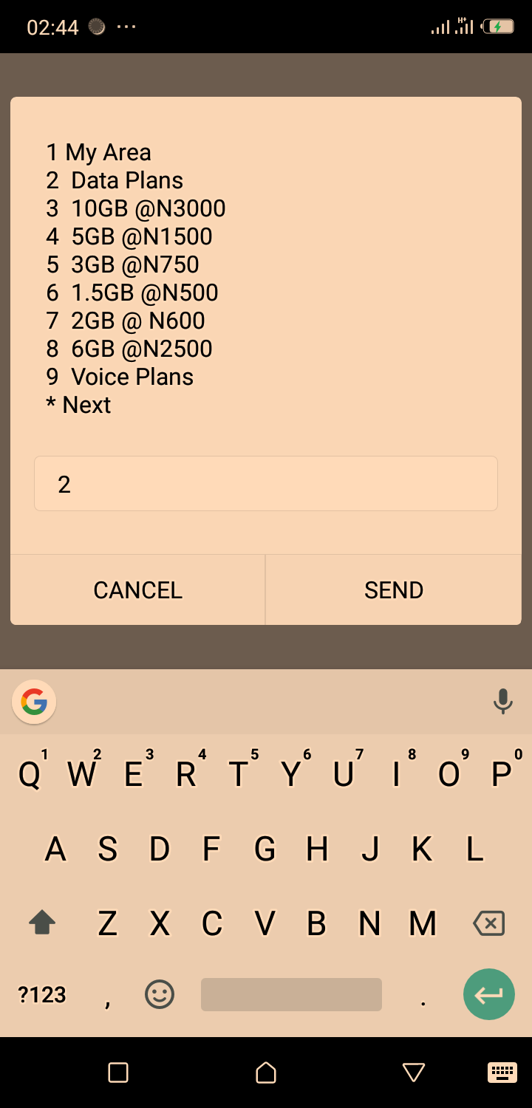
Transfer Money.
Account Number.
.
Bank.
Beneficiary Name.
Amount.
Reason For Transfer.
PIN.
.
Send.
Report.
Download Receipt.
Print Receipt.

Slide 14
Transaction Histories.
All.
Success.
Fail.
Pending.
Reversed.
Due.

Slide 15
Buy Airtime.
Personal Telephone Number / Beneficiary Number.
Select Service Provider.
Airtel.
Glo.
Etisalat.
M.T.N.
Available Units & Prices.
100
750
200
1000
500
1,500
Units Required.
Price.
PIN.
Buy.

Slide 16
Buy Data.
Personal Telephone Number / Beneficiary Number.
Select Service Provider.
Airtel.
Glo.
Etisalat.
M.T.N.
Available Units & Prices.
Daily.
Mega.
Weekly.
Amount.
Monthly.
Free Data.
Units Required.
Price.
PIN.
Buy.

